Slide 1
Run-time Environments
**Thanks to
Prof Y.N. Srikant Computer Science and Automation
Indian Institute of Science

Slide 2
What is Run-time Support?
It is not enough if we generate machine code from intermediate code
Interfaces between the program and computer system resources are needed.
There is a need to manage memory when a program is running
Other resources such as printers, file systems, etc., also need to be accessed
These are the main tasks of run-time support

Slide 3
Functionality of Runtime Environment
Need to consider
What do objects look like in memory?
What do functions look like in memory?
Where in memory should they be placed?
There are no right answers to these questions.
Many different options and tradeoffs.
Encoding types is to be performed
Primitive Types, Arrays, Functions

Slide 4
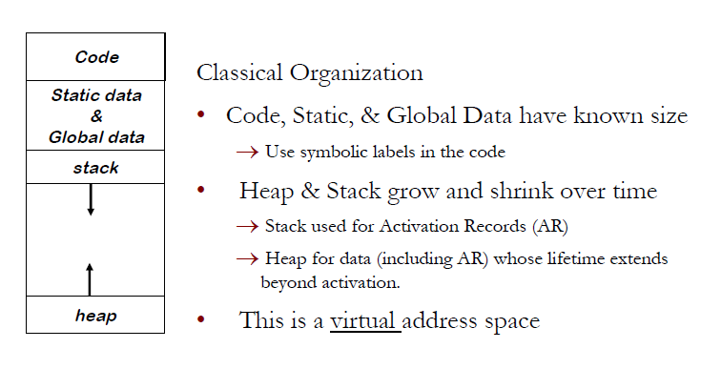
Runtime Storage Organization

Slide 5
Runtime Environment
Relationship between names and data objects (of target machine)
Allocation & de-allocation is managed by run time support package
Each execution of a procedure is an activation of the procedure. If procedure is recursive, several activations may be alive at the same time.
If a and b are activations of two procedures then their lifetime is either non overlapping or nested
A procedure is recursive if an activation can begin before an earlier activation of the same procedure has ended

Slide 6
Parameter Passing Methods Call-by-value
Basic terminology :
R- value: The value of an expression is called its r-value. The value contained in a single variable also becomes an r-value if its appear on the right side of the assignment operator. R-value can always be assigned to some other variable.
L-value: The location of the memory(address) where the expression is stored is known as the l-value of that expression. It always appears on the left side if the assignment operator.
Formal Parameter: Variables that take the information passed by the caller procedure are called formal parameters. These variables are declared in the definition of the called function.
Actual Parameter: Variables whose values and functions are passed to the called function are called actual parameters. These variables are specified in the function call as arguments.

Slide 7
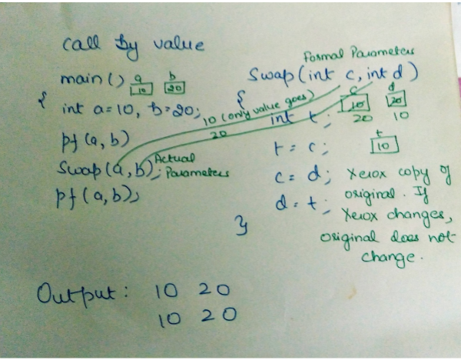
Parameter Passing Methods Call-by-value
In call by value the calling procedure pass the r-value of the actual parameters and the compiler puts that into called procedure’s activation record.
Formal parameters hold the values passed by the calling procedure, thus any changes made in the formal parameters does not affect the actual parameters.

Slide 8
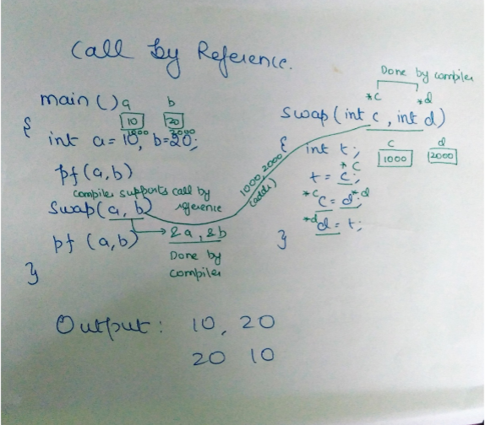
Parameter Passing Methods Call-by-reference
The formal and actual parameters refers to same memory location.
The l-value of actual parameters is copied to the activation record of the called function. Thus the called function has the address of the actual parameters.
If the actual parameters does not have a l-value (eg- i+3) then it is evaluated in a new temporary location and the address of the location is passed.
Any changes made in the formal parameter is reflected in the actual parameters

Slide 9
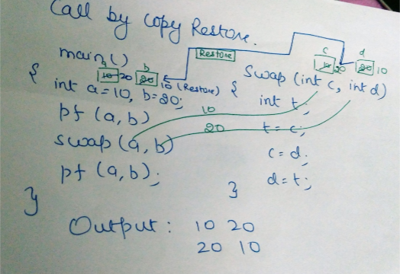
Call by Copy Restore
Compiler copies the value in formal parameters when the procedure is called and copy them back in actual parameters when control returns to the called function.
The r-values are passed and on return r-value of formals are copied into l-value of actuals

Slide 10
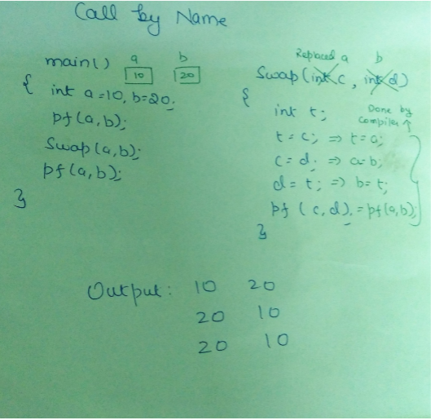
Call by Name
The actual parameters are substituted for formals in all the places formals occur in the procedure.
It is also referred as lazy evaluation because evaluation is done on parameters only when needed.

Slide 11
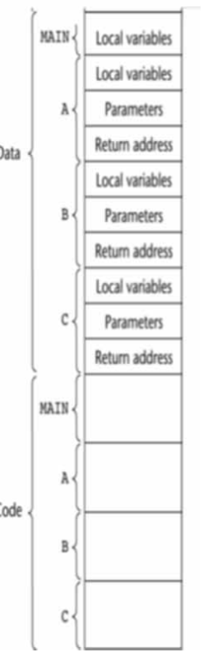
Code and Data Area in Memory
Most programming languages distinguish between code and data 
Code consists of only machine instructions and normally does not have embedded data
Data area of a program may grow or shrink in size during execution

Slide 12
Static Versus Dynamic Storage Allocation
Static allocation 
Compiler makes the decision regarding storage allocation by looking only at the program text.
Dynamic allocation
Storage allocation decisions are made only while the program is running
Stack allocation
Names local to a procedure are allocated space on a stack
Heap allocation
Used for data that may live even after a procedure call returns
Ex: dynamic data structures such as symbol tables
Requires memory manager with garbage collection

Slide 13
Static Data Storage Allocation
Compiler allocates space for all variables (local and global) of all procedures at compile time.
No stack/heap allocation; no overheads
Variable access is fast since addresses are known at compile time
No recursion

Slide 14
Dynamic Data Storage Allocation
Compiler allocates space only for global variables at compile time
Space for variables of procedures will be allocated at run-time
Stack/heap allocation
Ex: C, C++, Java, Fortran 8/9
Variable access is slow (compared to static allocation) since addresses are accessed through the stack/heap pointer
Recursion can be implemented

Slide 15
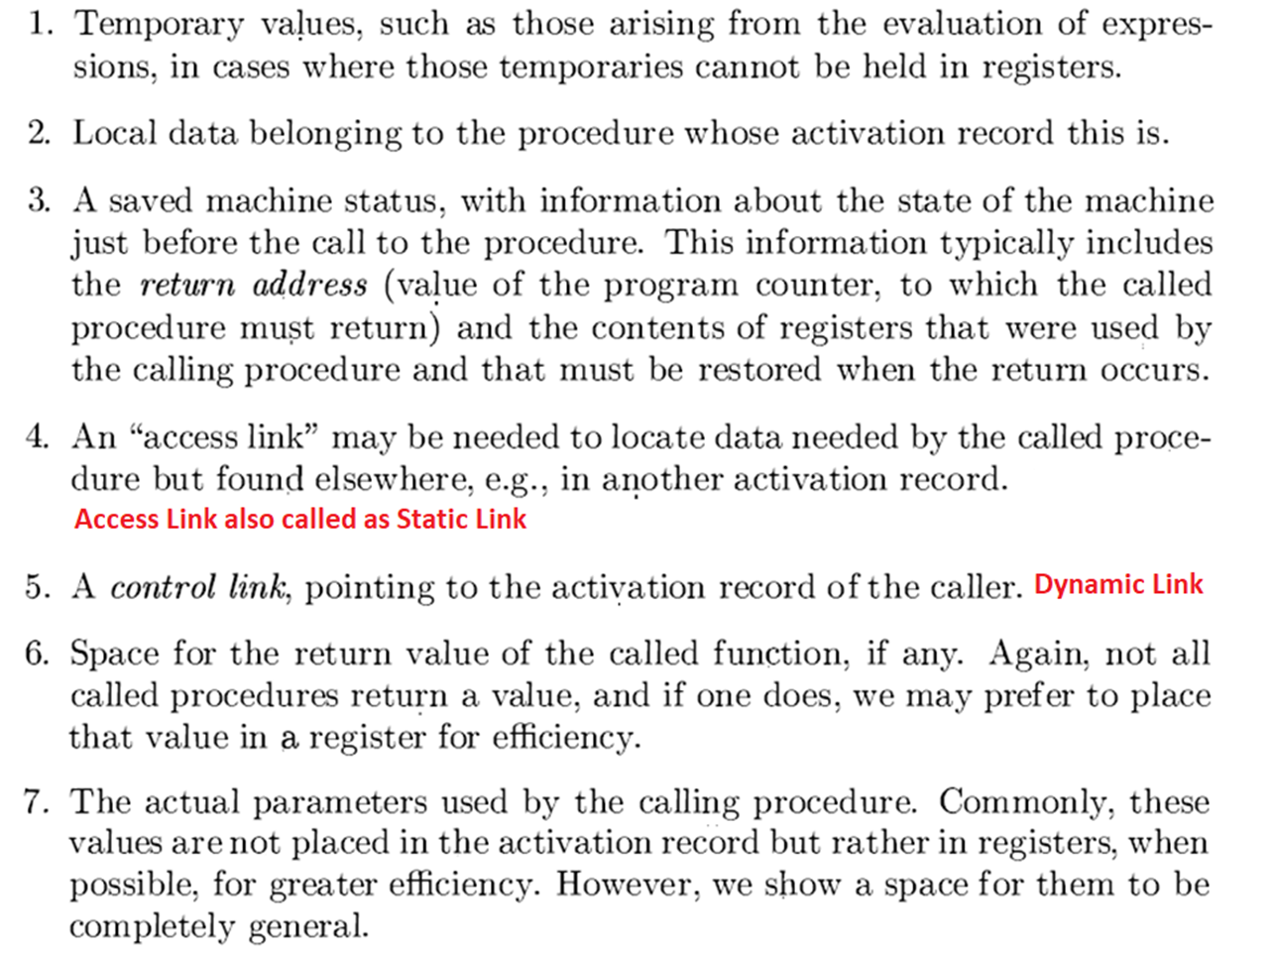
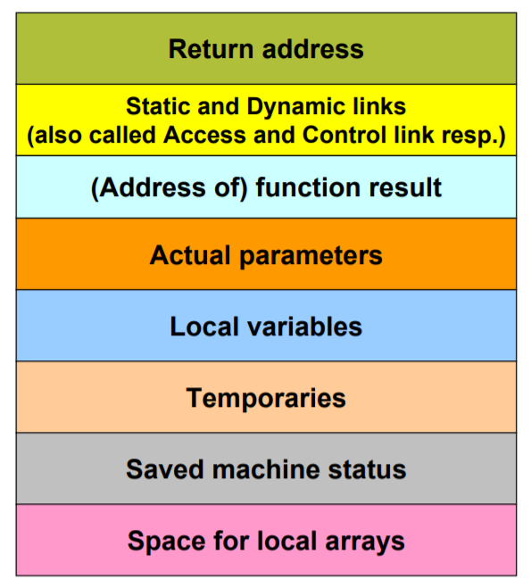
Activation Record Structure

Slide 16
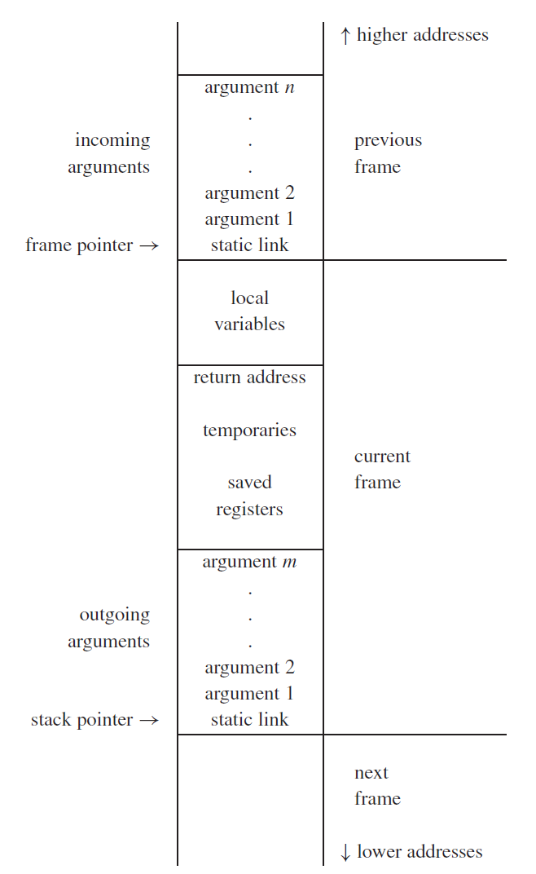

Slide 17
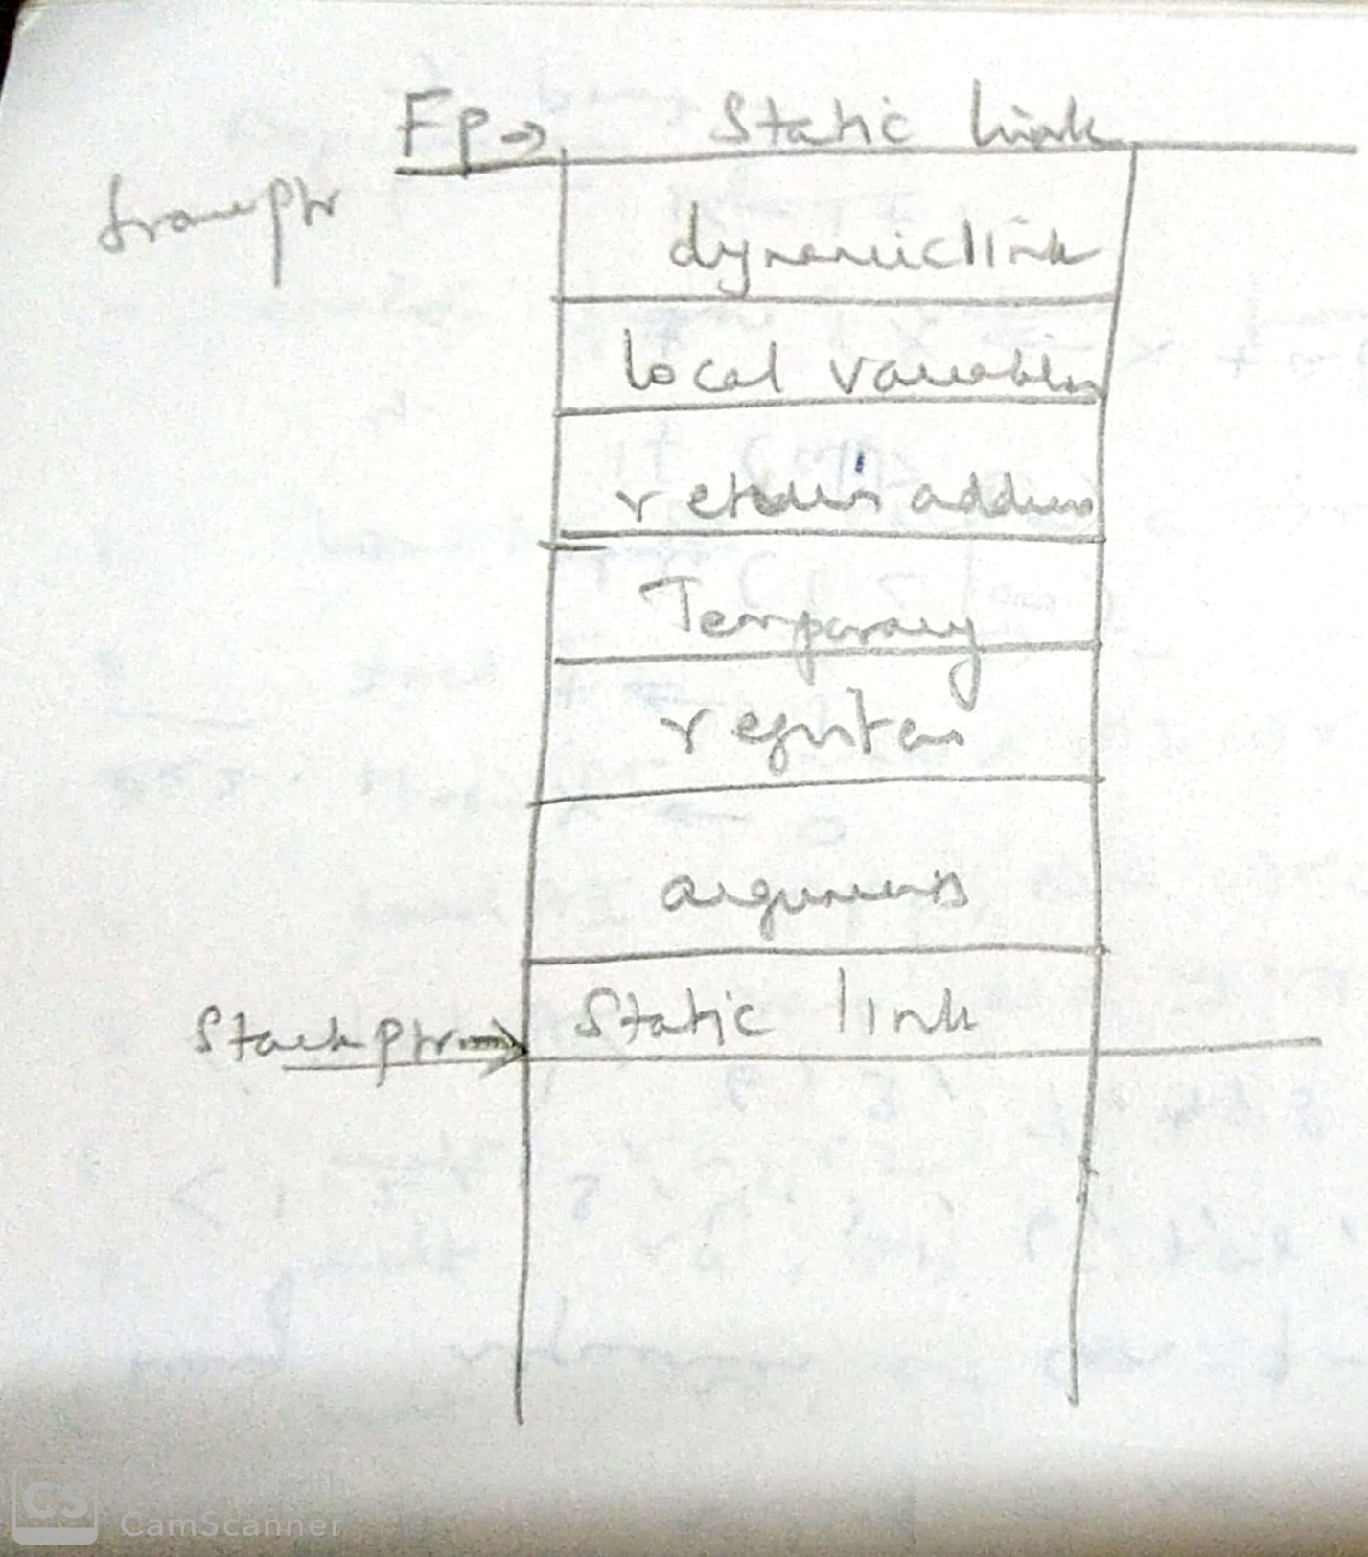
Frame layout to be followed by us

Slide 18
Variable Storage Offset Computation
The compiler should compute the offsets at which variables and constants will be stored in the activation record (AR)
These offsets will be with respect to the pointer pointing to the beginning of the AR
Variables are usually stored in the AR in the declaration order
Offsets can be easily computed while performing semantic analysis of declarations

Slide 19
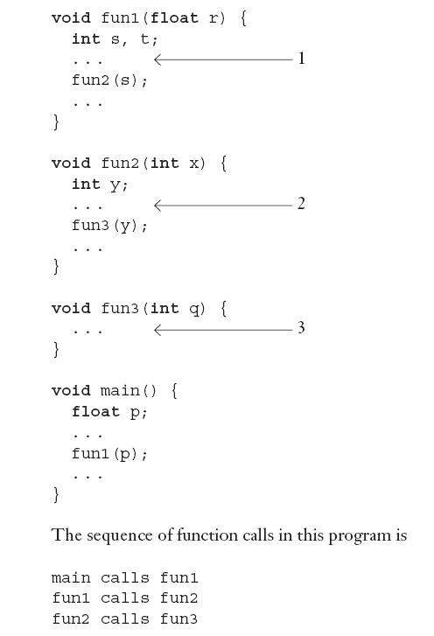

Slide 20
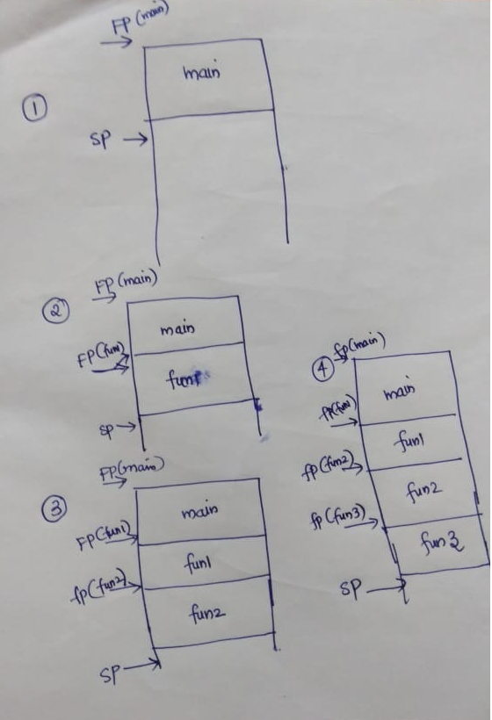

Slide 21
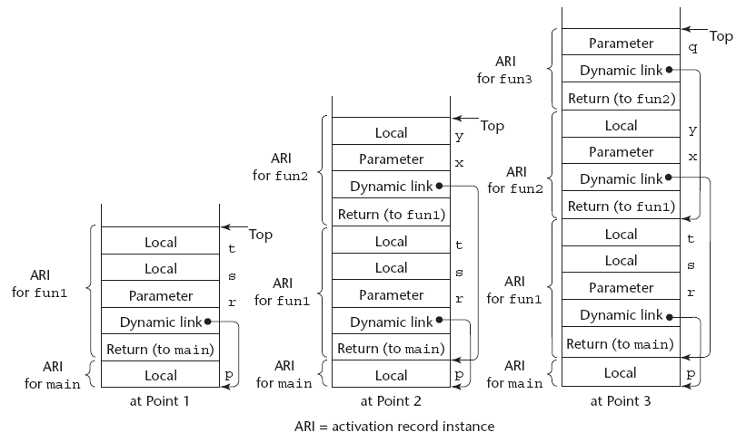

Slide 22
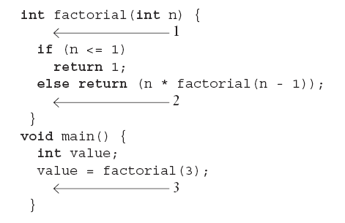
Recursion

Slide 23
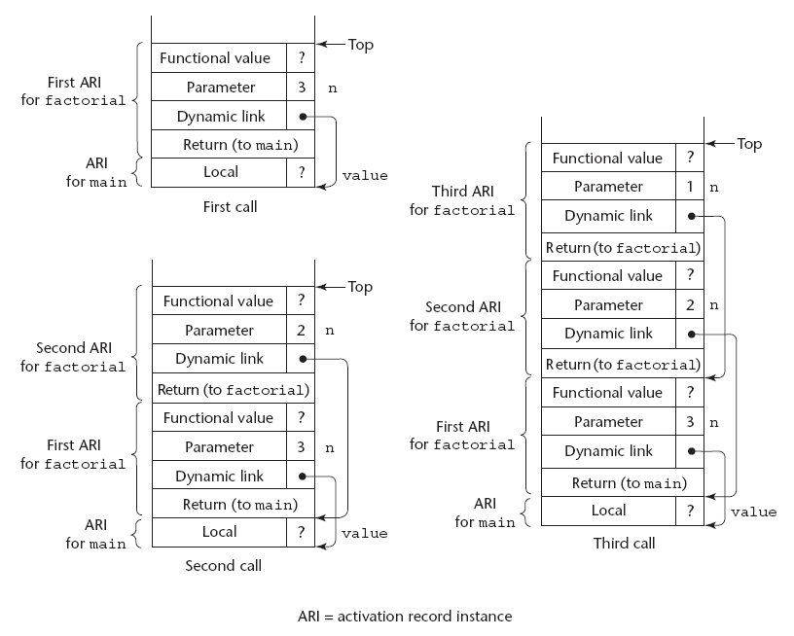

Slide 24
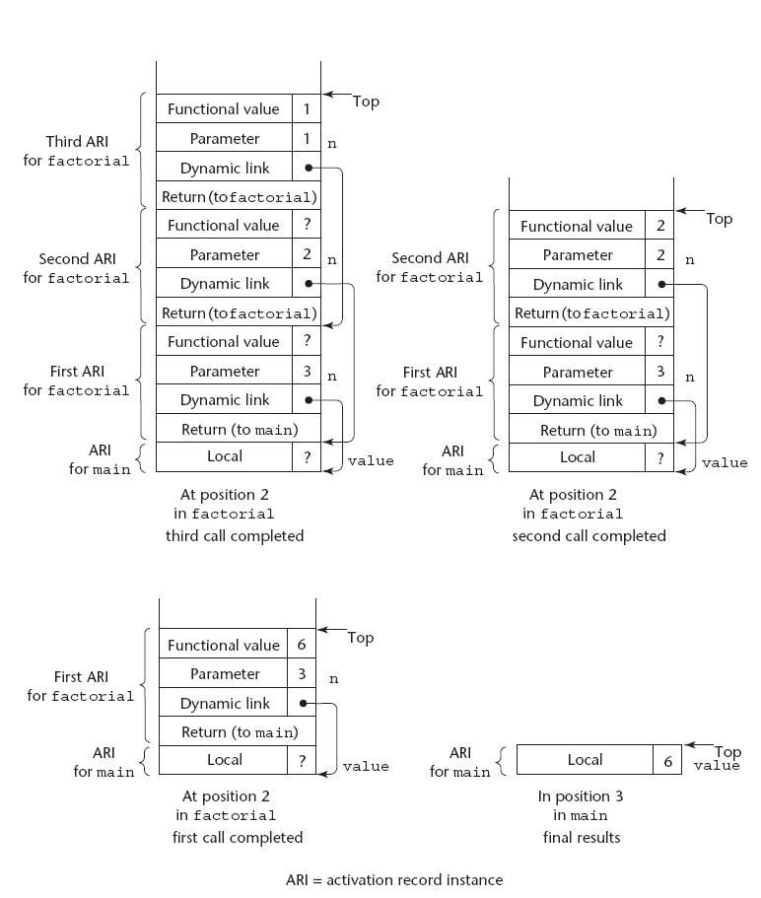

Slide 25
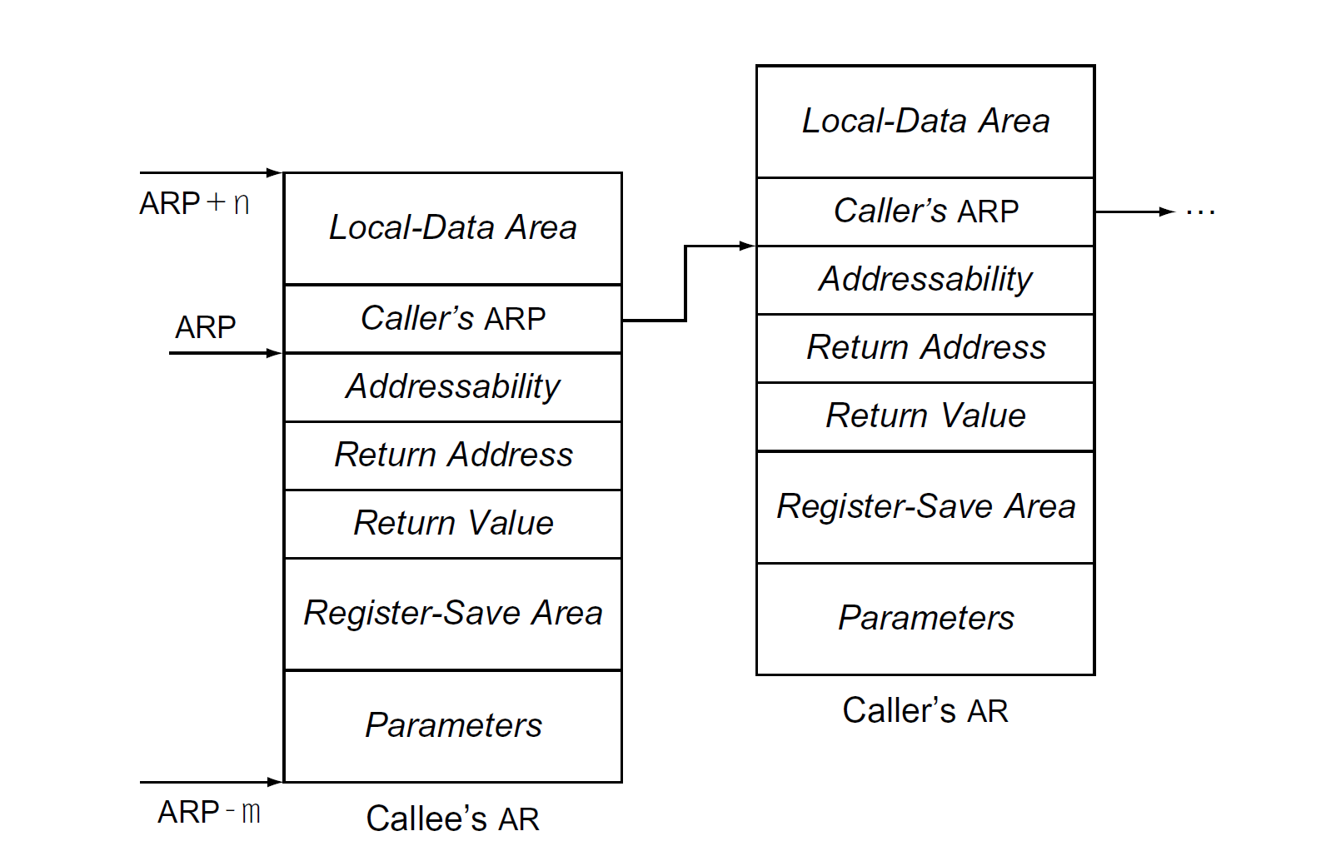

Slide 26
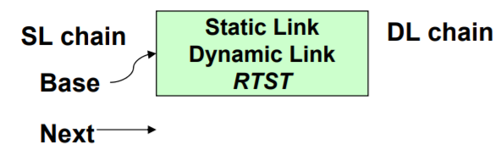
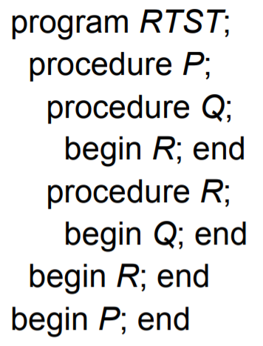
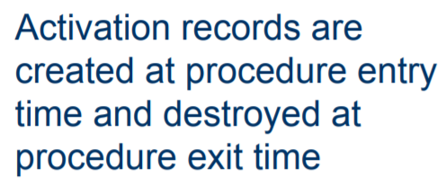

Allocation of Activation Records

Slide 27
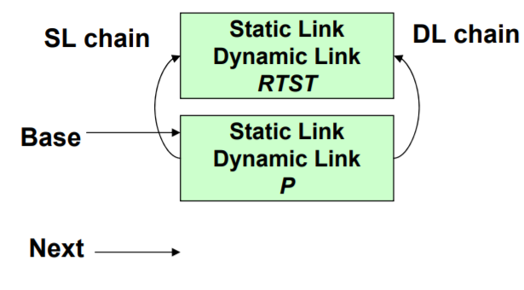
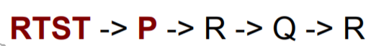
Allocation of Activation Records

Slide 28

Allocation of Activation Records

Slide 29
Allocation of Activation Records

Slide 30
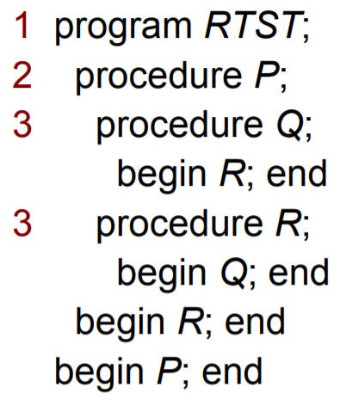
Allocation of Activation Records

Slide 31
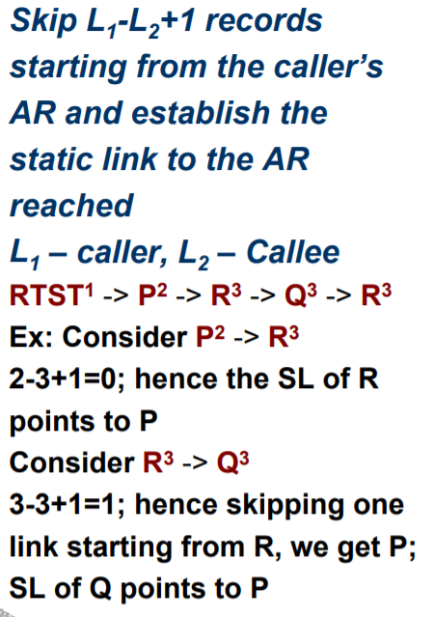
Allocation of Activation Records

Slide 32
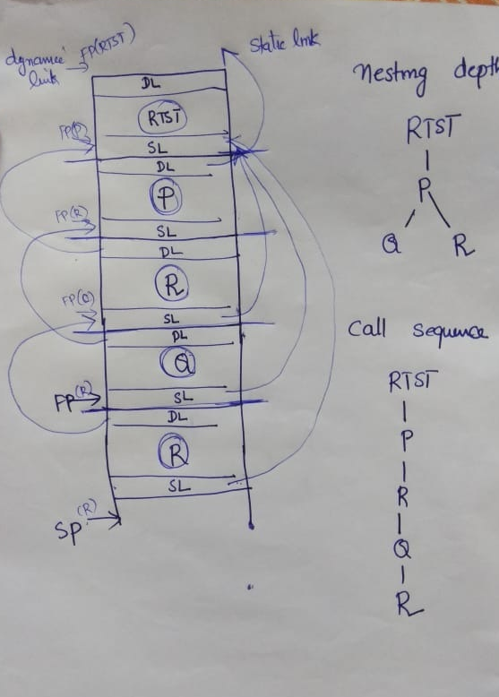

Slide 33
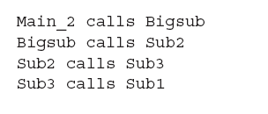
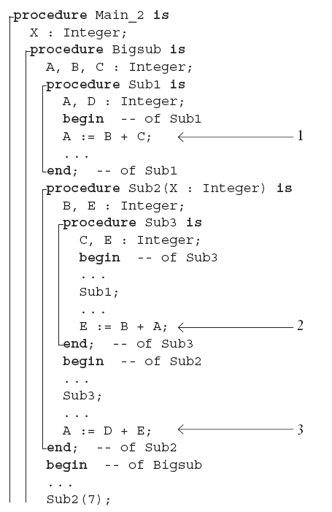
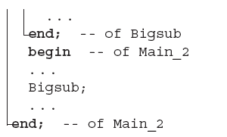

Slide 34
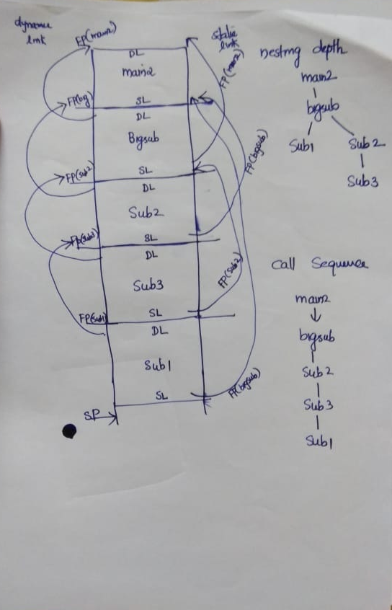

Slide 35
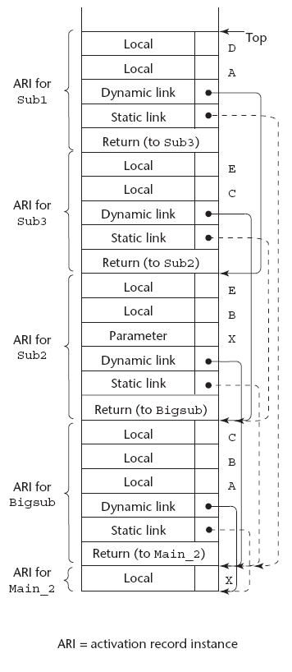

Slide 36
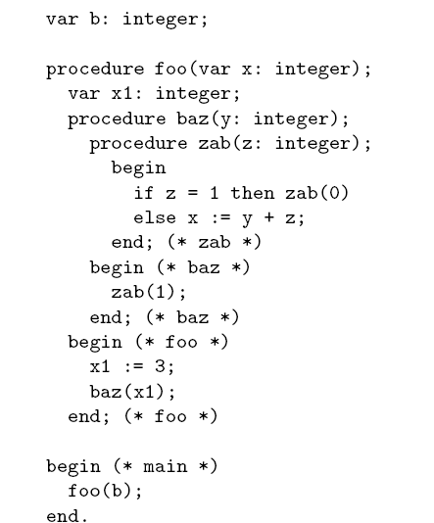

Slide 37
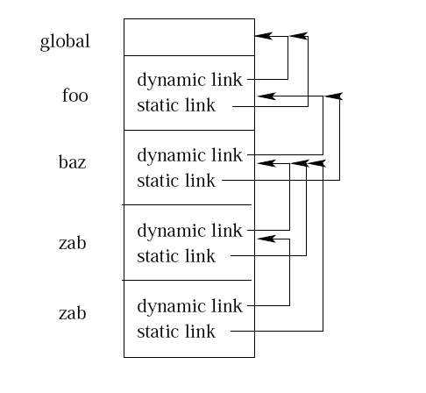

Slide 38
Show the stack with all activation record instances, including static and dynamic chains, when execution reaches the indicated position in the skeleton program below. Assume Bigsub is a level 1 and the order of subprogram invocation is Bigsub calls A, A calls B, B calls A, A calls C, C calls D.
procedure Bigsub;
procedure A;
procedure B;
end; {B}
end; {A}
procedure C;
procedure D;
end; {D}
end; {C}
end; {Bigsub}

Slide 39
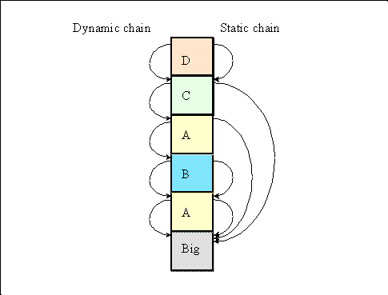
Solution

Slide 40
#include <stdio.h>
int x = 4;
void printx(void) {printf("%d\n", x);}
void foo(int y) {
int x = 4;
x = x + x * y;
printx();
}
void main() {
int z = 3;
printx();
foo(z);
}

Slide 41
Activation Trees
An activation tree is a tree structure representing all of the function calls made by a program on a particular execution.
Depends on the runtime behaviour of a program; can't always be determined at compile-time.
(The static equivalent is the call graph).
Each node in the tree is an activation record.
Each activation record stores a control link to the activation record of the function that invoked it.

Slide 42
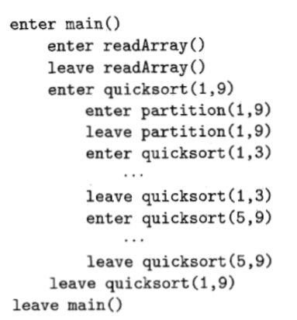
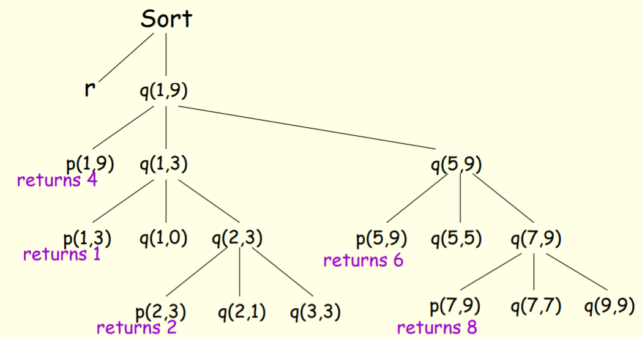
1. program sort(input, output);
2. var a: array [0..10] of integer;
3. x, i: integer;
4. procedure readarray;
5. var i : integer;
6. begin … a… end { readarray } ;
7. procedure quicksort(m, n : integer);
8. var i: integer;
9. function partition(y, z : integer) : integer;
10. var i, j,x,v : integer;
11. begin … a …
12. … v …
13. end { partition }
19. begin
20. i:= partition (m,n);
21. quicksort (m,i-1);
22. quicksort(i+1, n);
23. end { quicksort }
24. begin
25. readarray;
26. quicksort(1,9)
27. end { sort }

Slide 43
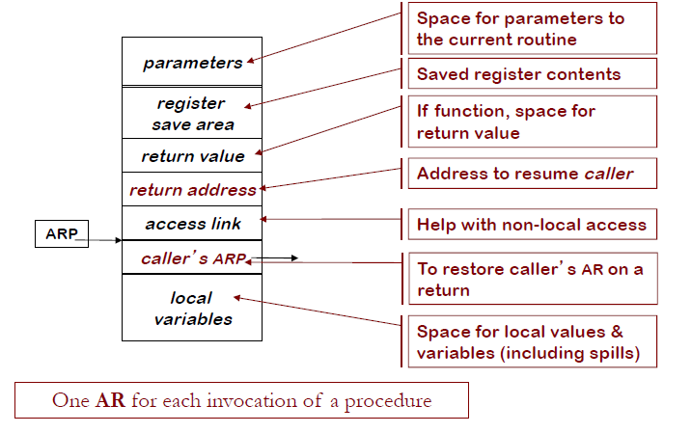
Activation Record Basic Structure

Slide 44
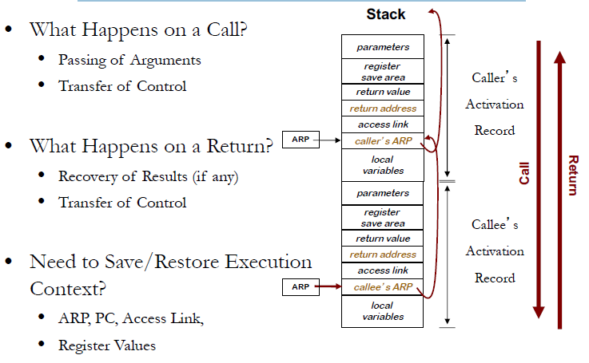
Activation Records on the Stack
Memorizing the ARP is in the form of Control link

Slide 45
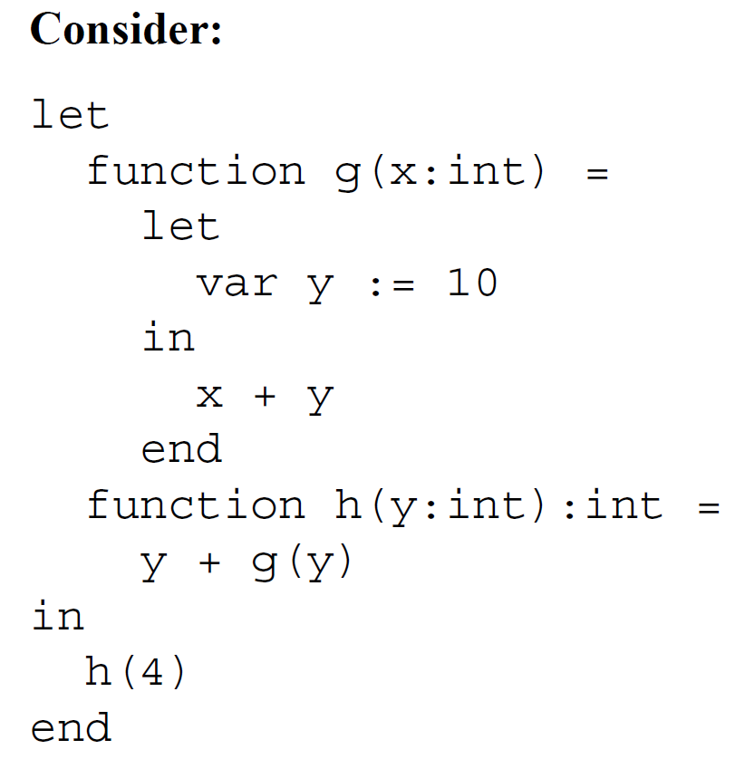
Example
h
g

Slide 46
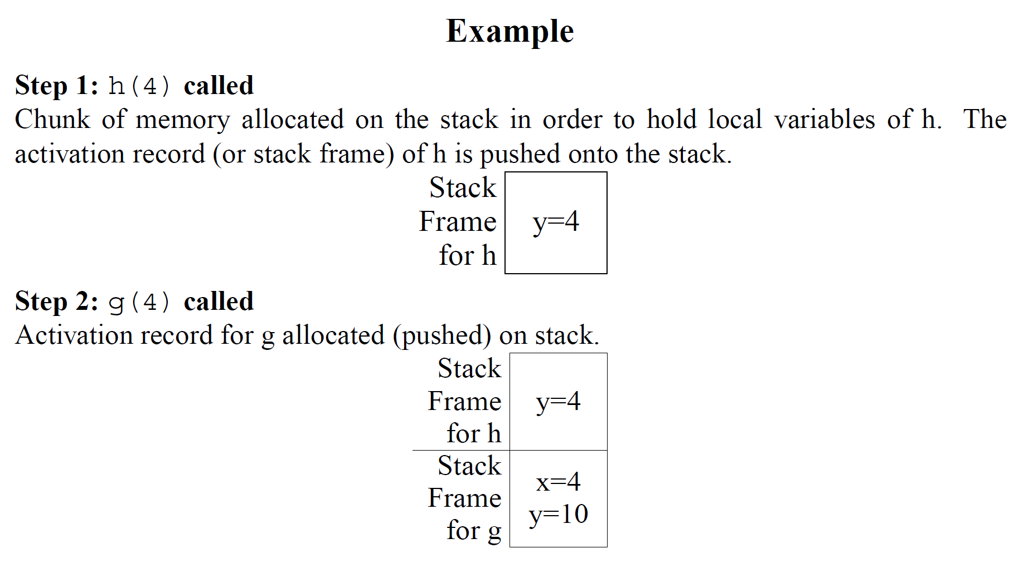

Slide 47
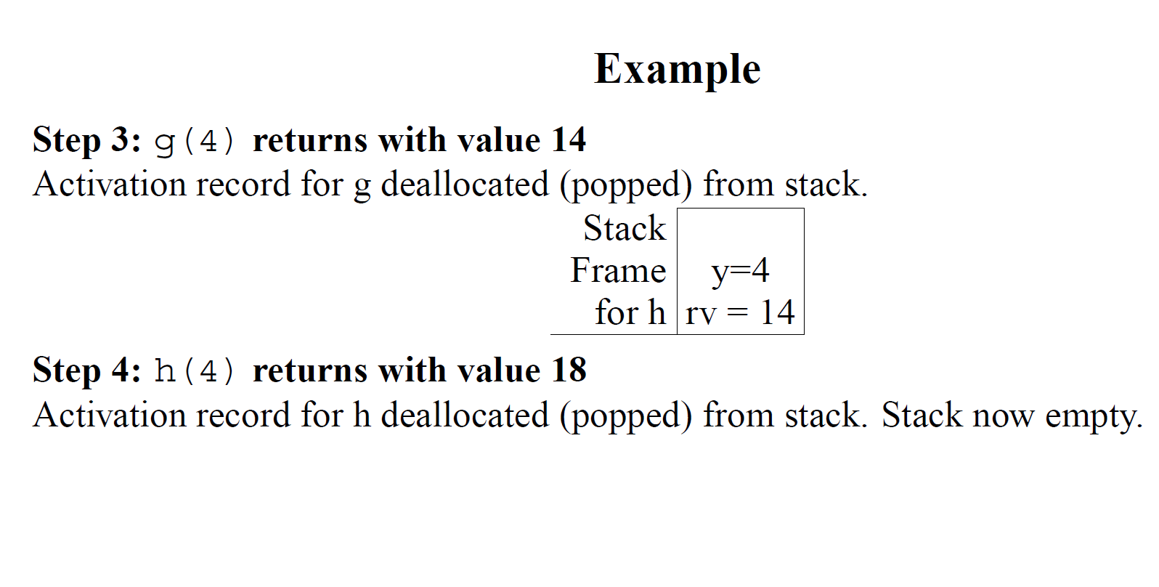

Slide 48
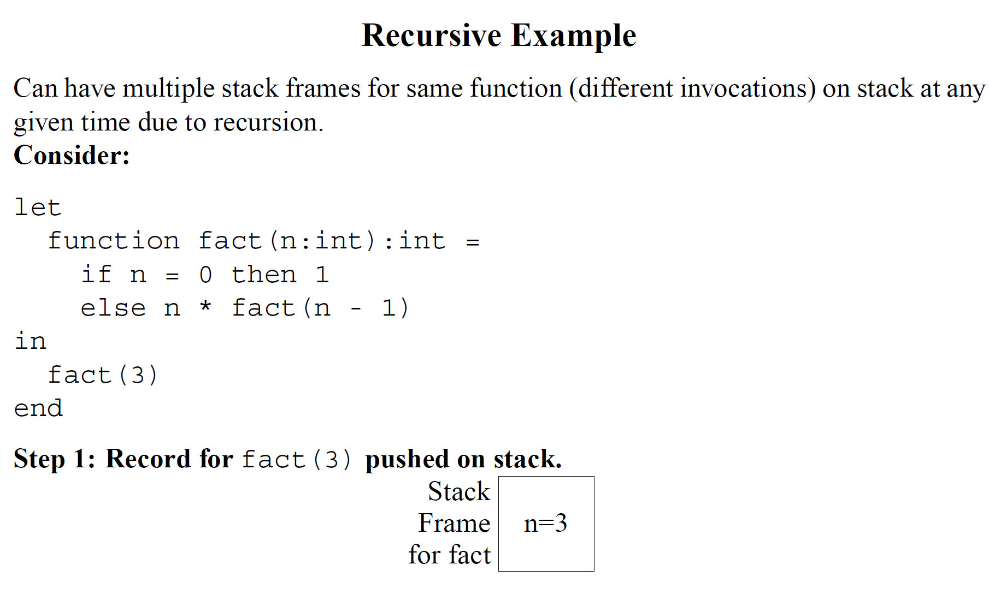
fact

Slide 49
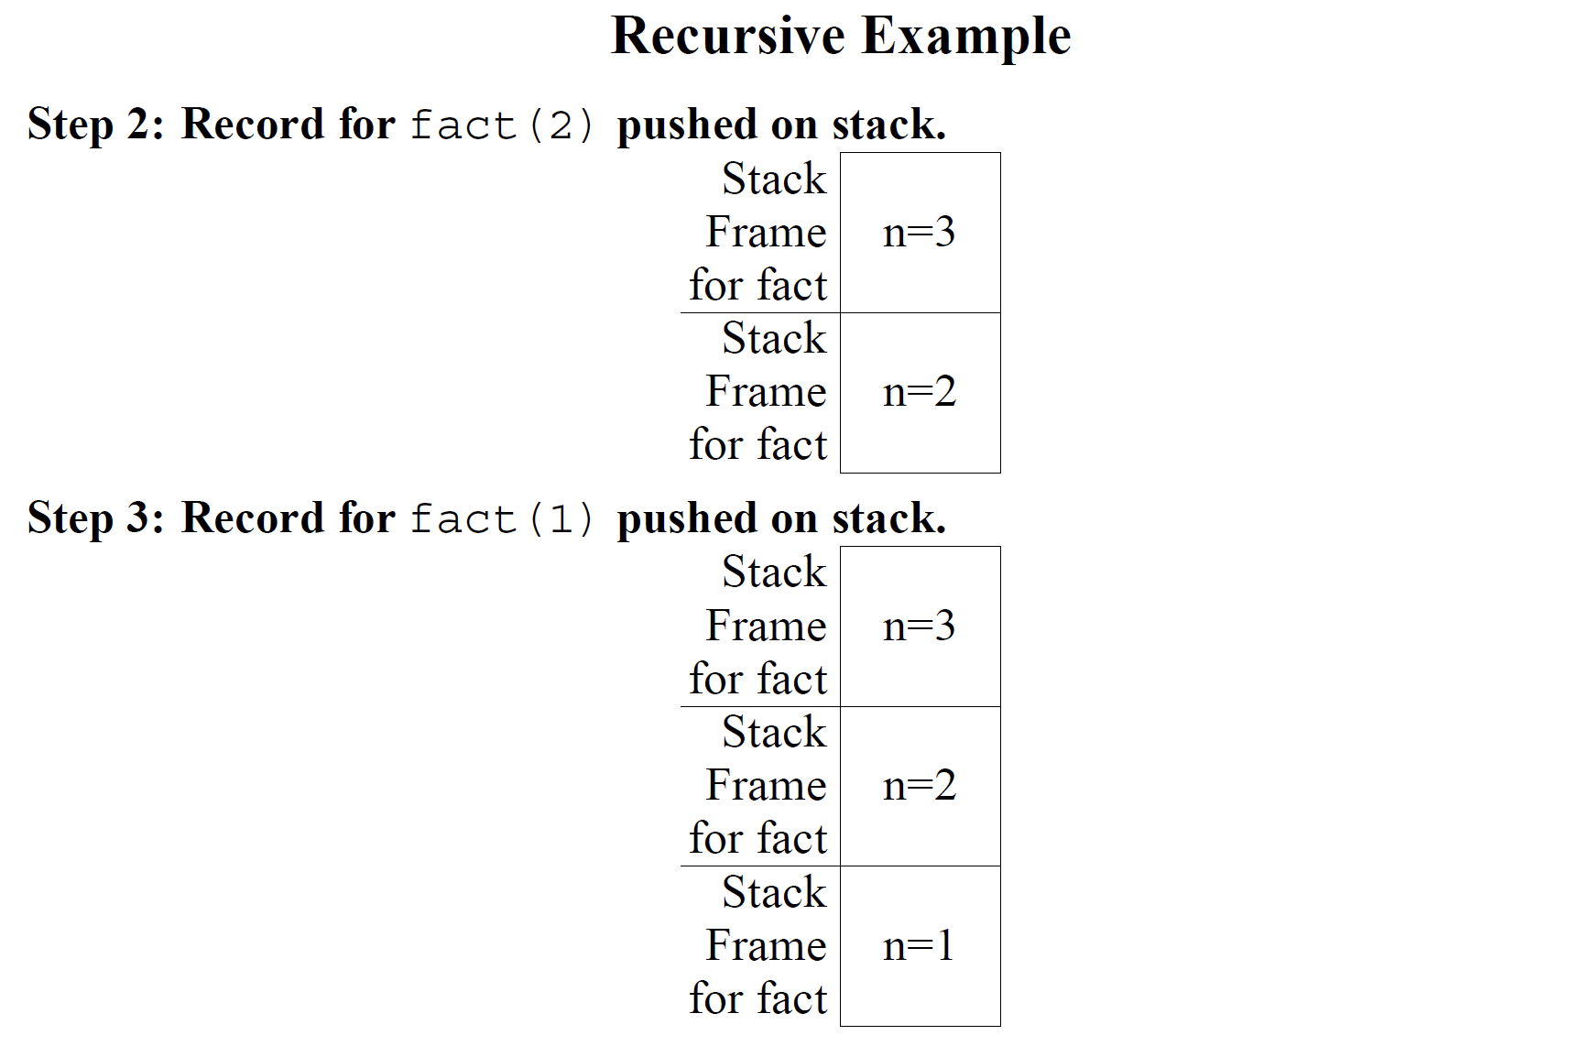

Slide 50
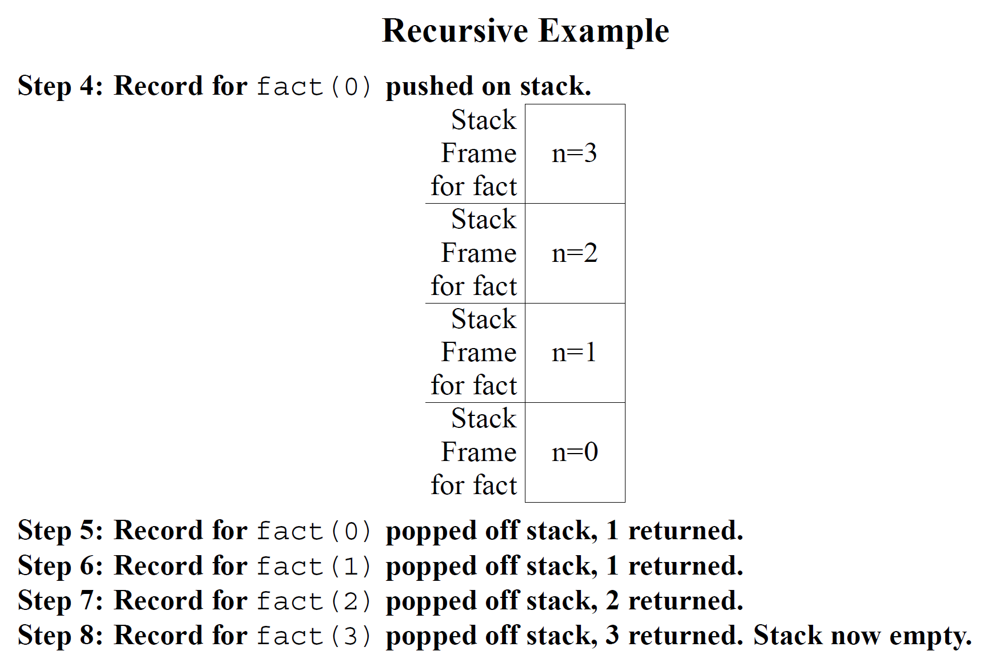

Slide 51
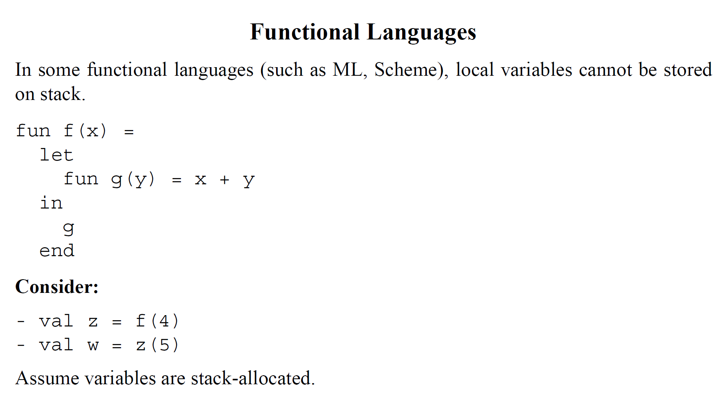

Slide 52
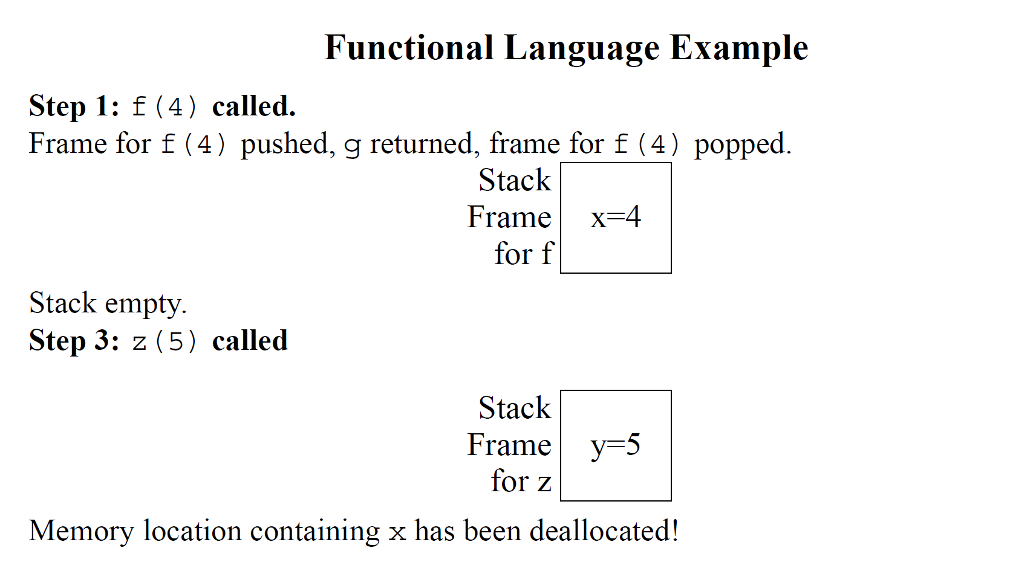
Therefore, Activation Records can be implemented in heap rather than stack

Slide 53
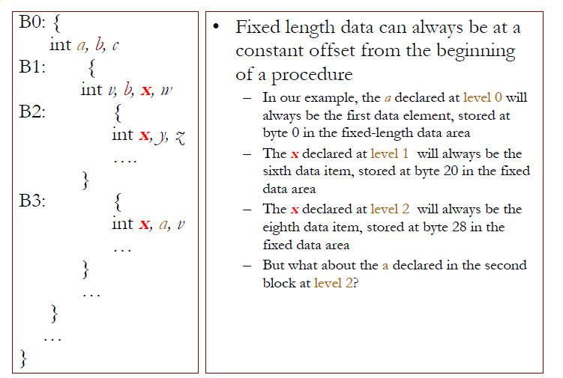
Storage for Blocks within a Single Procedure

Slide 54
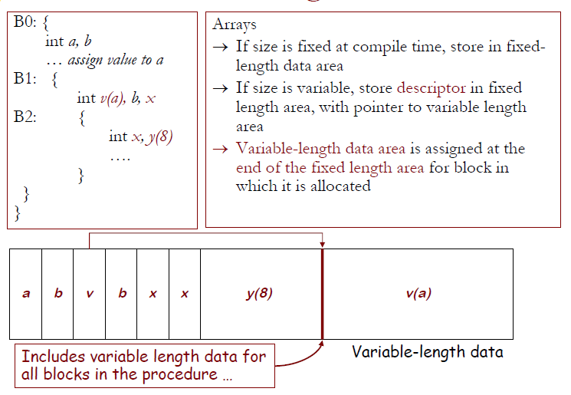
Variable-length Data

Slide 55
Access to local and global variable
Access to Local variables:
Stack relative: variable is synonymous with relative location of the activation record (+/- offset to stack)
Current ARP + offset
Access method for global variables:
Compiler determines relative address of variable wrt to module/file into .data/.bss segment
Linker merges all segments into a single segment and changes the offsets -> leads to global address
Special handling of dynamically loaded modules

Slide 56
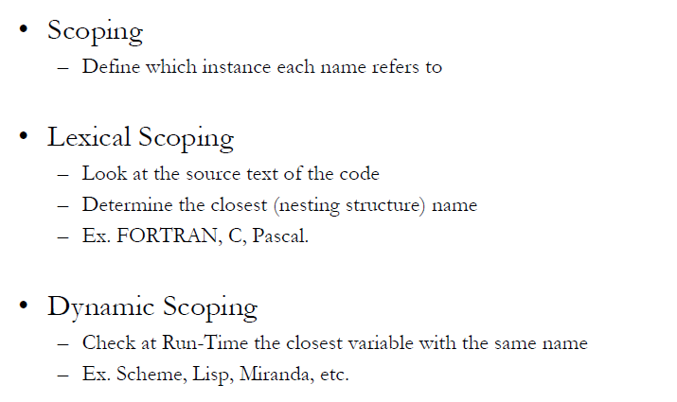
Scoping Rules

Slide 57
Access to non local variables
Include a field ‘access link’ in the activation record
If p is nested in q then access link of p points to the access link in most recent activation of q
Access nonlocal name in lexical scoping:
To implement access to nonlocal data a in procedure p, the compiler generates code to traverse np - na access links to reach the activation record where a resides
np is the nesting depth of procedure p
na is the nesting depth of the procedure containing a
Therefore, address of a non local a in procedure p can be stored in symbol table as
(np-na, offset of a in record of activation having a )

Slide 58
Scope with nested procedures
procedure quicksort(m,n:integer);
var k,v : integer;
function partition(y,z:integer):
integer;
var i,j: integer;
begin
end;
begin
.
end;
begin
.
end.
Program sort;
var a: array[1..n] of integer;
x: integer;
procedure readarray;
var i: integer;
begin
end;
procedure exchange(i,j:integer)
begin
end;
Notes:
The example on slide 29 contains a program in Pascal with nested procedure sort
readarray
exchange
quicksort
partition
Here we apply the most closely nested rule for deciding scoping of variables and procedure names. The procedure exchange called by partition, is non-local to partition. Applying the rule, we first check if exchange is defined within quicksort; since it is not, we look for it in the main program sort.

Slide 59
Access links for non-locals
sort
quicksort(1,9)
quicksort(1,3)
Stack
partition(1,3)
exchange(i,j)
Notes:
Shown are the access links for finding storage for non-locals

Slide 60
Activation Records on the Stack
Sort
access link
control link
a,x
Sort
access link
control link
a,x
Readarray
access link
control link
i
Sort
access link
control link
a,x
quicksort(1,9)
access link
control link
k,v
Nil
Nil
Nil
Nil
Nil
Nil

Slide 61
Activation Records on the Stack
Sort
access link
control link
a,x
quicksort(1,9)
access link
control link
k,v
partition(1,9)
access link
control link
i,j
Sort
access link
control link
a,x
quicksort(1,9)
access link
control link
k,v
partition(1,9)
access link
control link
i,j
exchange(1,9)
access link
control link
Nil
Nil
Nil
Nil

Slide 62
Dynamic Scoping
Binding of non local names to storage do not change when new activation is set up
A non local name a in the called activation refers to same storage that it did in the calling activation
Deep Access
Dispense with access links
use control links to search into the stack
term deep access comes from the fact that search may go deep into the stack
Shallow Access
hold current value of each name in static memory
when a new activation of p occurs a local name n in p takes over the storage for n
previous value of n is saved in the activation record of p

Slide 63
Activation tree
Control flows sequentially
Execution of a procedure starts at the beginning of body
It returns control to place where procedure was called from
A tree can be used, called an activation tree, to depict the way control enters and leaves activations
The root represents the activation of main program
Each node represents an activation of procedure
The node a is parent of b if control flows from a to b
The node a is to the left of node b if lifetime of a occurs before b

Slide 64
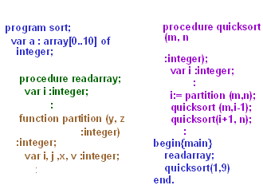
Example

Slide 65
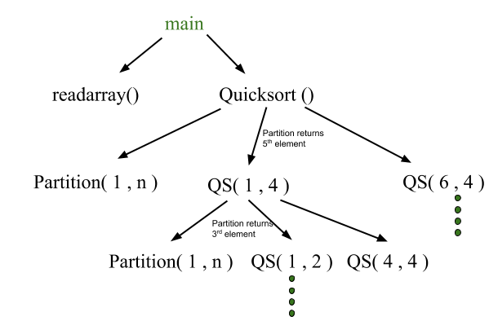
Quick Sort
main() {
Int n;
readarray();
quicksort(1,n);
}
quicksort(int m, int n) {
Int i= partition(m,n);
quicksort(m,i-1);
quicksort(i+1,n);
}

Slide 66

Sequence
The flow of control of the call quicksort(1,9) would be like
Execution begins ..
enter readarray
exit readarray
enter quicksort(1,9)
enter partition(1,9)
exit partition(1,9)
enter quicksort(1,3)
exit quicksort(1,3)
enter quicksort(5,9)
exit quicksort(5,9)
exit quicksort(1,9)
Execution terminates

Slide 67

Control stack for the above quicksort example:

Slide 68


Slide 69

Display

Slide 70
Display Stack of Activation Records

Slide 71

Example

Slide 72






(a)
(b)
(c)
(f)
(d)
(e)

Slide 73



(g)
(h)
(i)

Slide 74
Static Scope and Dynamic Scope
Static Scope
A global identifier refers to the identifier with that name that is declared in the closest enclosing scope of the program text
Uses the static (unchanging) relationship between blocks in the program text
Dynamic Scope
A global identifier refers to the identifier associated with the most recent activation record
Uses the actual sequence of calls that are executed in the dynamic (changing) execution of the program
Both are identical as far as local variables are concerned

Slide 75

Static Scope and Dynamic Scope

Slide 76


Slide 77

Static Scope and Dynamic Scope

Slide 78


Slide 79
Lexical scoping vs dynamic scoping –Example 1
Lexical scoping
x1
x1= 1
calls c()
x2
calls b()
x1=2
Prints x1= 2
Program a()
{
x: integer;
x=1;
procedure b()
{
x=2;
}
procedure c()
{
x: integer;
b();
}
c();
print x;
}
Dynamic scoping
x1
x1= 1
calls c()
x2
calls b()
x2=2
Prints x1= 1

Slide 80


Slide 81
Lexical scoping vs dynamic scoping – Home work
VAR count: INTEGER;
PROCEDURE procX
BEGIN
VAR count: INTEGER;
SET count TO 100;
CALL report
END
PROCEDURE procY
BEGIN
SET count TO 200;
CALL report
END
PROCEDURE report
BEGIN
PRINT “count =” + count
END
MAIN PROGRAM
BEGIN
SET count TO 300;
CALL procX;
CALL procY
END
int n = 1; // global
print_plus_n(int x) {
cout << x + n;
}
increment_n() {
n = n + 2;
print_plus_n(n);
}
test() {
int n;
n = 200;
print_plus_n(7);
n = 50;
increment_n();
cout << n;
}

Slide 82
Ans
Static
8 ,6 and 50
Dynamic
207, 104, 52
Static
300, 200
Dynamic
100, 200

Slide 83


Slide 84


Slide 85

Nested Lexical Scope - translating local names
In a given scope, each name refers to its lexically closest declaration.

Slide 86

Original program
(a) Example Pascal Program
(c) Execution History

Slide 87

Nested Lexical Scopes
(a) Pascal Program
(d) Calling Relationships

Slide 88


Nested Dynamic scope
 | x | y | z
Main | <1,0> | <1,4> | <1,8>
Fie | <1,0> | <2,0> | <1,8>
Foe | <1,0> | <2,0> | <3,0>
Fee | <2,0> | <2,0> | <3,0>
Fum | <1,0> | <4,0> | <3,0>
Fee | <2,0> | <4,0> | <3,0>
(b) Dynamic coordinates

Slide 89


Slide 90
Try it Yourself
What is the output of this program if the static scoping is used?
a. 5
b. 5
b. What is the output of this program if the dynamic scoping is used?
a. 2
b. 8

Slide 91

Procedure Linkage

Slide 92

Procedure Linkage

Slide 93

Procedure Linkage

Slide 94

Procedure Linkage

Slide 95

Procedure Linkage

Slide 96

Procedure Linkage
The linkage divides responsibility between caller and callee
At compile time, we generate the code to do this
At run time, that code manipulates the frame & data areas

Slide 97
Thank You ☺

